Slide 1
Generative Adversarial Network

Slide 2
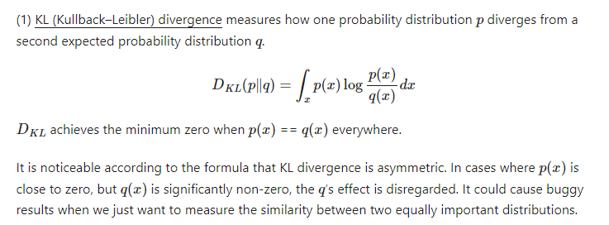
Kullback–Leibler Divergence

Slide 3
Notes:
https://lilianweng.github.io/posts/2017-08-20-gan/

Slide 4
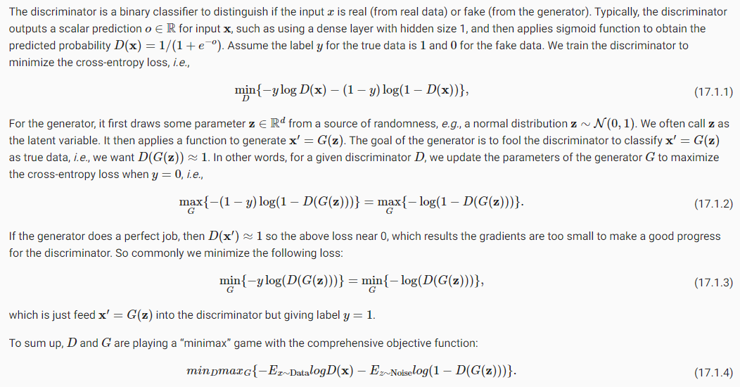
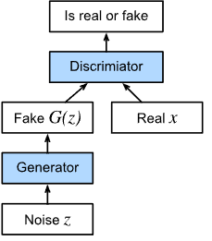
GAN
Notes:
https://d2l.ai/chapter_generative-adversarial-networks/gan.html

Slide 5
notebook

Slide 6
Problem in GANS
Hard to achieve Nash equilibrium
Low dimensional supports
Vanishing gradient

Slide 7
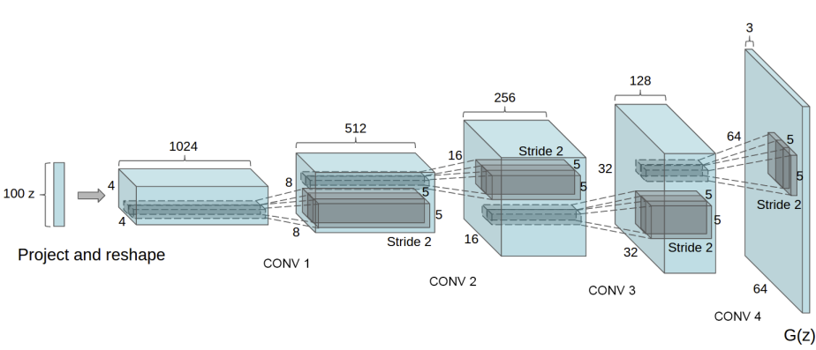
DCGAN

Slide 8
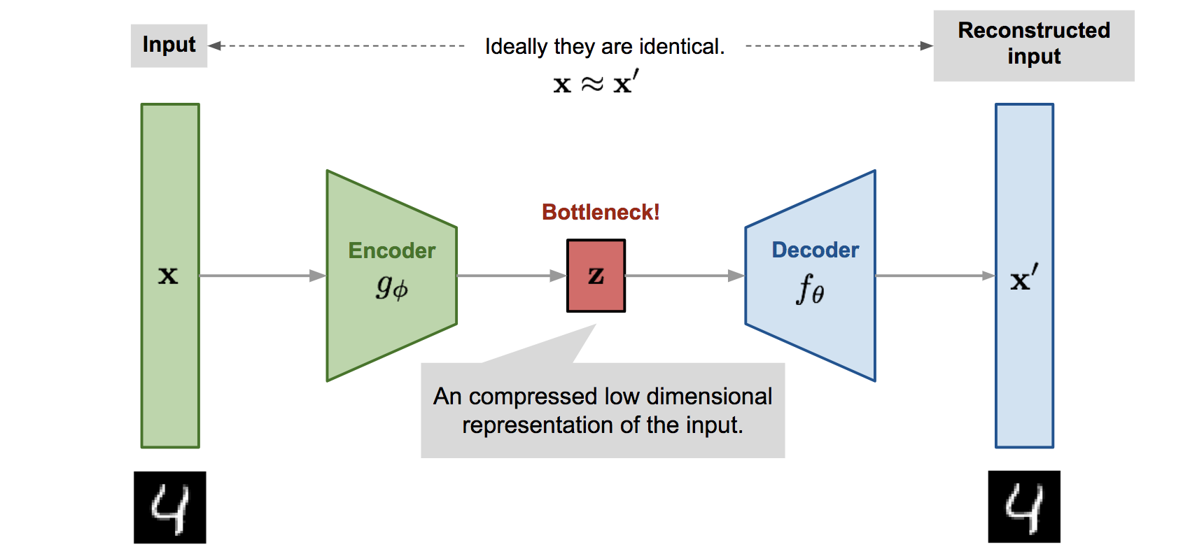
Auto Encoder
Notes:
https://lilianweng.github.io/posts/2018-08-12-vae/

Slide 9
Auto Encoder
notebook

Slide 10
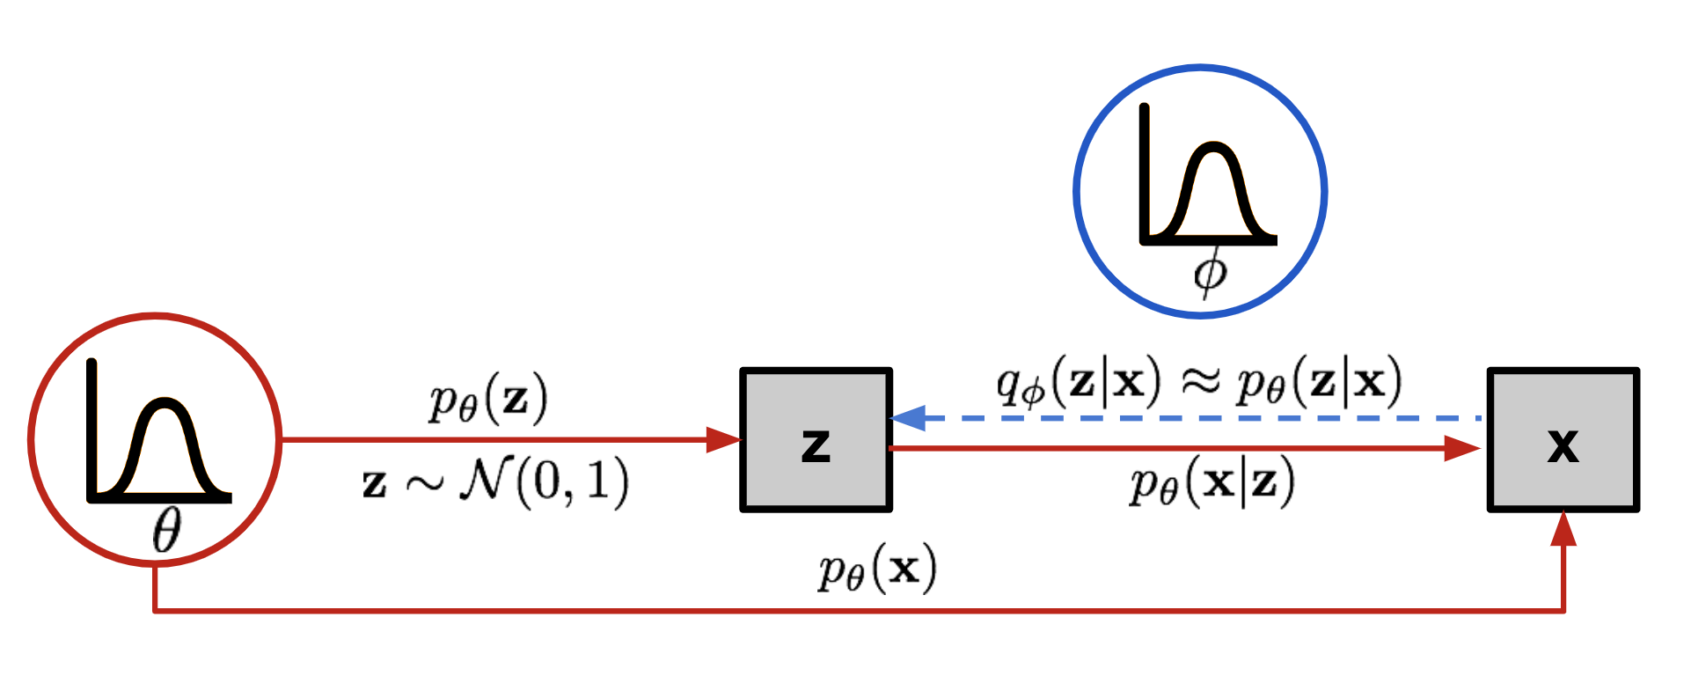
Variational Auto Encoder

Slide 11
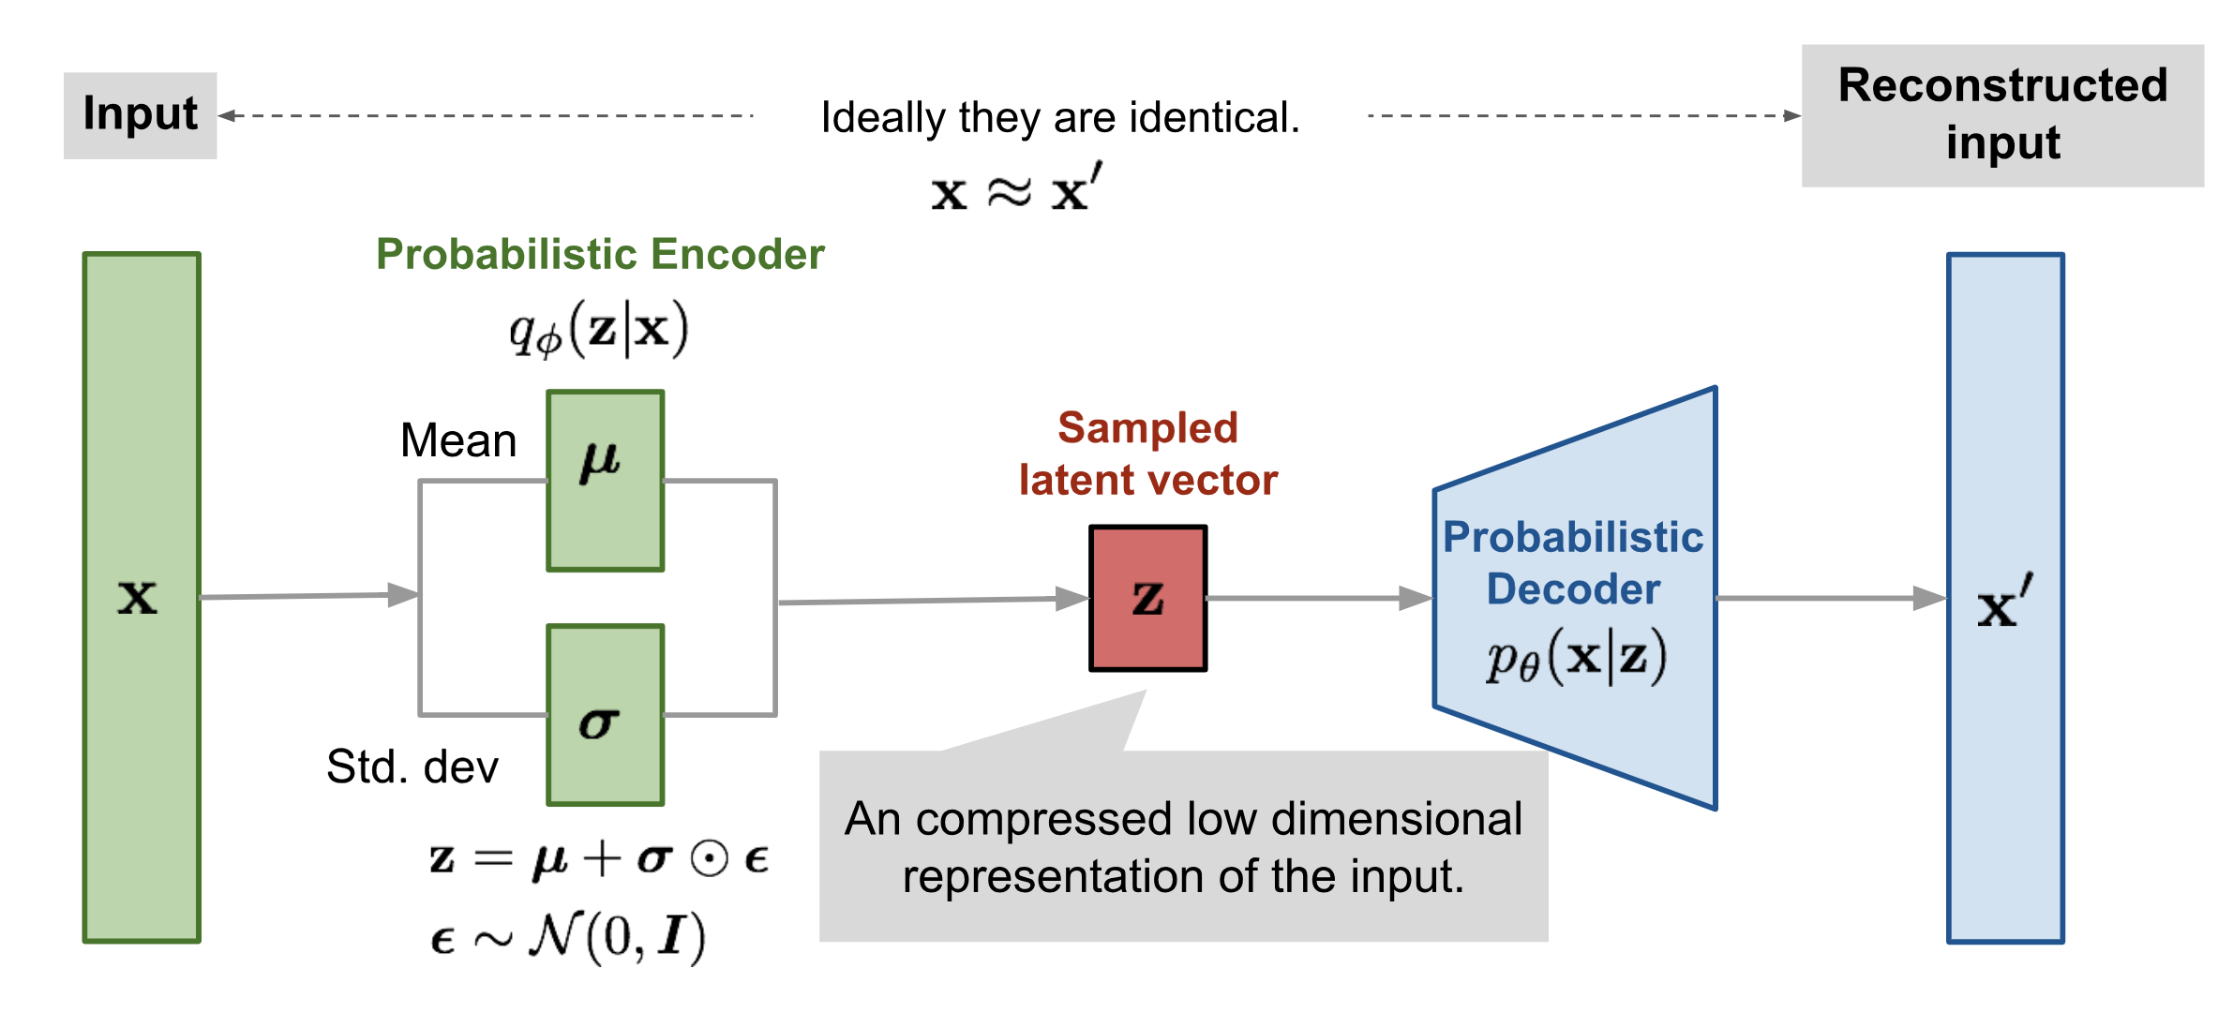
Variational Auto Encoder

Slide 12
VAE
Notebook

Slide 13
Practice
DC GAN pokemon generation

